Slide 2
Gal 3:10
“For all who rely on works of the law are under a curse; for it is written, "Cursed be everyone who does not abide by all things written in the Book of the Law, and do them."

Slide 3
V6-8 "Woe to him who heaps up what is not his own— for how long? — and loads himself with pledges!" Will not your debtors suddenly arise, and those awake who will make you tremble? Then you will be spoil for them. Because you have plundered many nations, all the remnant of the peoples shall plunder you, for the blood of man and violence to the earth, to cities and all who dwell in them.”

Slide 4
James 3:16 “For where jealousy and selfish ambition exist, there will be disorder and every vile practice.”

Slide 5
V9-11 “Woe to him who gets evil gain for his house, to set his nest on high, to be safe from the reach of harm! You have devised shame for your house by cutting off many peoples; you have forfeited your life. For the stone will cry out from the wall, and the beam from the woodwork respond.”

Slide 6
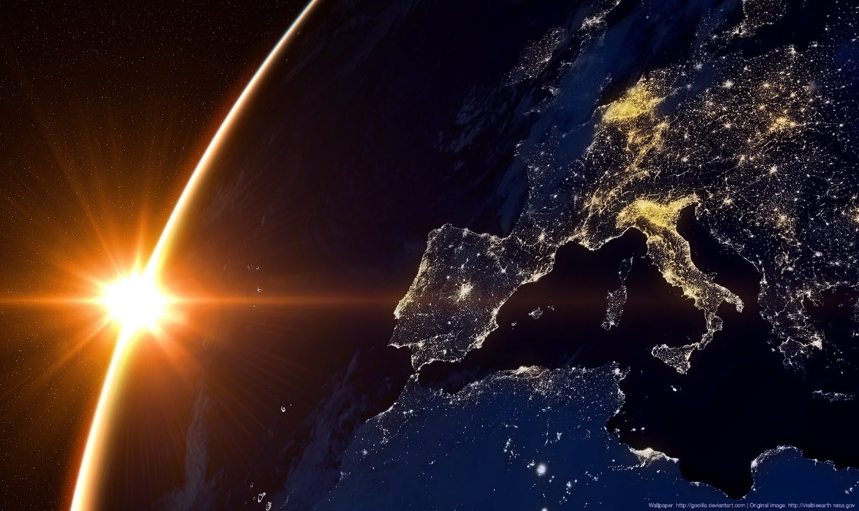
1 Thess 5:3-4
“While people are saying, "There is peace and security," then sudden destruction will come upon them as labor pains come upon a pregnant woman, and they will not escape. But you are not in darkness, brothers, for that day to surprise you like a thief.”

Slide 7
V12-14 "Woe to him who builds a town with blood and founds a city on iniquity! Behold, is it not from the Lord of hosts that peoples labor merely for fire, and nations weary themselves for nothing? For the earth will be filled with the knowledge of the glory of the Lord as the waters cover the sea.”

Slide 8
V15-17 "Woe to him who makes his neighbors drink— you pour out your wrath and make them drunk, in order to gaze at their nakedness! You will have your fill of shame instead of glory. Drink, yourself, and show your uncircumcision! The cup in the Lord's right hand will come around to you, and utter shame will come upon your glory! The violence done to Lebanon will overwhelm you, as will the destruction of the beasts that terrified them, for the blood of man and violence to the earth, to cities and all who dwell in them.”

Slide 9
V18-19 "What profit is an idol when its maker has shaped it, a metal image, a teacher of lies? For its maker trusts in his own creation when he makes speechless idols! Woe to him who says to a wooden thing, Awake; to a silent stone, Arise! Can this teach? Behold, it is overlaid with gold and silver, and there is no breath at all in it.”

